Slide 1
Pandora Online Movie Rental Store

Slide 2
Group members
1.Helina Tigistu 2.Lealem Kifle 3.Massame Degelo 4.Meron Hailemeskel

Slide 3
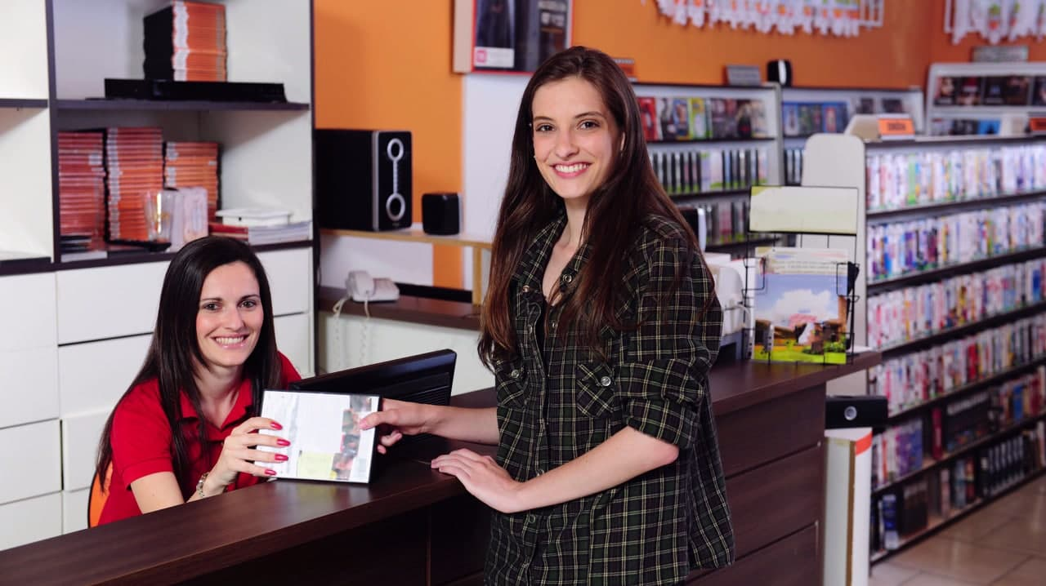

Slide 4
Introduction
1
3
Pandora is a website built using MVC.NET framework. This website is supposed to be used at video rental stores.
ADMIN has two different roles which are managing movies and customers
2
4
It has two different users ADMIN and STAFF MEMBER
STAFF MEMBER has only one role which is managing customers

Slide 5
There are 4 links on the navigation bar
A
New Rental
B
Customers
C
Movies
D
Rentals

Slide 6
The 4 nav bar links has the follwing features
Rentals
Customers
Listing all Rentas with pagination feature
Sorting
Searching
Deleting Rental
Listing all customers with pagination feature
Sorting
Searching
Deleting customer
Adding new customer
New Rental
Used for renting movies
Accepts customer name and list of movies that the customer wishes to rent
Has a business rule which returns a validation error if the movie is not in the database
Movies
Listing all movies with pagination feature
Sorting
Searching
Deleting movie
Adding new movie

Slide 7
Functional Requirement
1
The system shall provide registration for users to become members
The system shall allow the members to search movies
4
2
The system shall allow the members to change its password
The system shall allow to rent movies
5
3
The system shall provide customers different type of membership.
The system shall provide a separate role for admin and staff members
6

Slide 8
Functional Requirement con’t
7
The system shall allow admins to add, delete and edit customer and movie
8
The system shall allow staff member to add, delete and edit customer.

Slide 9
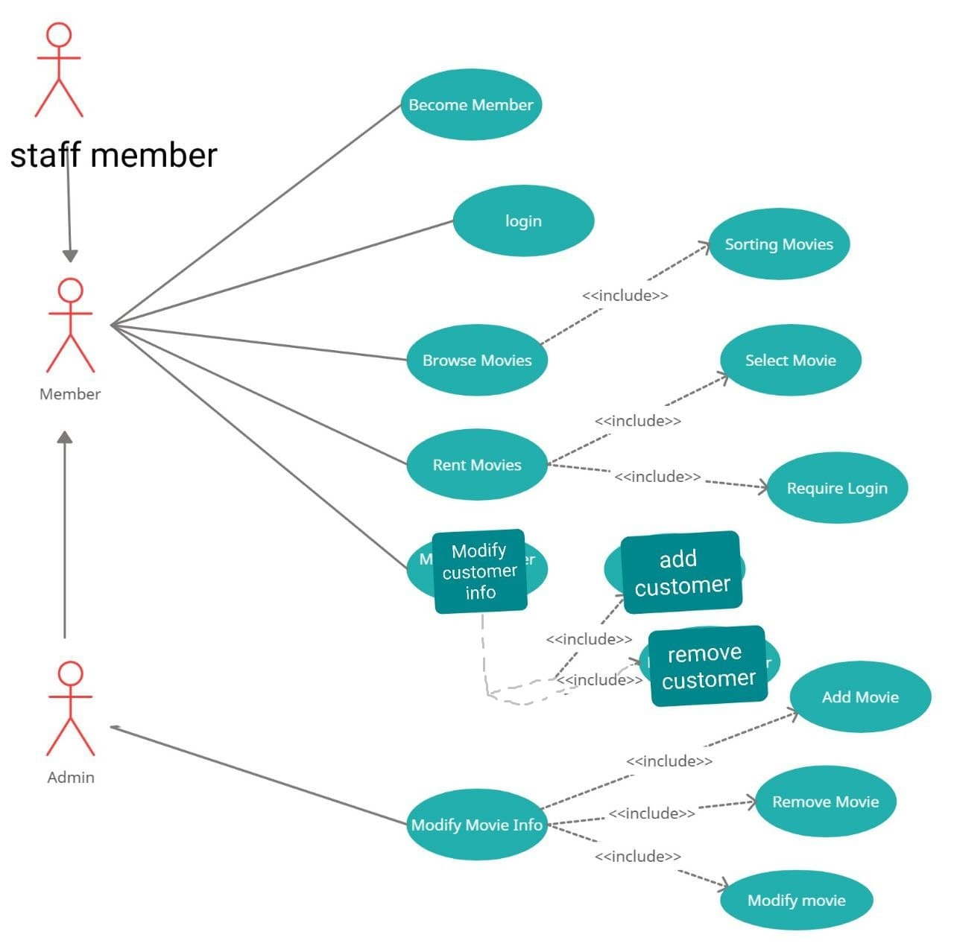
Use-Case
Diagram

